Slide 1
Data Feminism

Slide 2
Starting terms
Feminism: “shorthand for the diverse and wide-ranging projects that name and challenge sexism and other forces of oppression, as well as those which seek to create more just, equitable, and livable futures” (6-7)
Intersectionality: “intersecting aspects of a person’s identity” as well as “intersecting forces of privilege and oppression” (7-8)
Notes:
Intersectionality: I have the intersecting privileges of being white and college educated, and I have the intersecting oppression of being female and being not neurotypical?
Black woman intersectionality

Slide 3
Who wrote this?
Book authors: Catherine D’Ignazio and Lauren F. Klein (see handout for details)
Presentation author: Catherine DeJager (I’m a white, female university student majoring in CS and minoring in data science, math, and linguistics)

Slide 4
Table of Contents
The Power Chapter (examine power)
Collect, Analyze, Imagine, Teach (challenge power)
On Rational, Scientific, Objective Viewpoints from Mythical, Imaginary, Impossible Standpoints (elevate emotion and embodiment)
What Gets Counted Counts (rethink binaries and hierarchies)
Unicorns, Janitors, Ninjas, Wizards, and Rock Stars (embrace pluralism)
The Numbers Don’t Speak for Themselves (consider context)
Show Your Work (make labor visible)
Conclusion: Now Let’s Multiply

Slide 5
Chapter 1: The Power Chapter
(examine power)

Slide 6
Matrix of Domination
Structural domain Organizes oppression: laws and policies | Disciplinary domain Administers and manages oppression. Implements and enforces laws and policies.
Hegemonic domain Circulates oppressive ideas: culture and media | Interpersonal domain Individual experiences of oppression
Table 1.1 The four domains of the matrix of domination
Chart based on concepts introduced by Patricia Hill Collins in Black Feminist Thought: Knowledge, Consciousness, and the Politics of Empowerment
Notes:
“Current configuration of structural privilege and structural oppression”. How the systems of power are configured and experienced. (sociologist Patricia Hill Collins, from Black Feminist Thought in 1990).

Slide 7
Questions to ask
Data science by whom?
Data science for whom?
Data science with whose interests and goals?

Slide 8
Terms
Minoritized: “a social group is actively devalued and oppressed by a dominant group, one that holds more economic, social, and political power” (26)
Privilege hazard:
context: “When data teams are primarily composed of people from dominant groups, those perspectives come to exert outsized influence on the decisions being made--to the exclusion of other identities and perspectives”
definition: being “poorly equipped to recognize instances of oppression in the world” because you don’t experience it (28)
Notes:
Example of privilege hazard

Slide 9
Chapter 2: Collect, Analyze, Imagine, Teach (challenge power)
Notes:
Data feminism commits to challenging unequal power structures and working toward justice

Slide 10
Challenge power
Analyze and expose oppression
The pitfalls of proof
Envision equity, imagine co-liberation
Teach data like an intersectional feminist

Slide 11
The pitfalls of proof
What if a person/administration refuses to change unless provided with proof?
“On whom is the burden of proof placed?” (58)
“Any data-based evidence can be minimized” (58)
Deficit narratives: “reduce a group or culture to its “problems,” rather than portraying it with the strengths, creativity, and agency that people from those cultures possess” (58)
Notes:
minoritized

Slide 12
Envision equity, imagine coliberation
From data ethics to data justice (Table 2.1, page 60)
Concepts that secure power Because they locate the source of the problem in individuals or technical systems | Concepts that challenge power Because they acknowledge structural power differentials and work toward dismantling them
Ethics | Justice
Bias | Oppression
Fairness | Equity
Accountability | Co-liberation
Transparency | Reflexivity
Understanding algorithms | Understanding history, culture, and context
Equity: a kind of justice that takes into account “time, history, and differential power” (62)
Co-liberation: “free the people”; dominant groups and minoritized groups working together (“requires a commitment to and a belief in mutual benefit”) (63)
Reflexivity: “the ability to reflect on and take responsibility for one’s own position within the multiple, intersecting dimensions of the matrix of domination” (64)
Notes:
“Concepts that secure power” is like “technicism” in Schuurman’s book. Restorative justice: “decisions should be made in ways that recognize and rectify any harms of the past” (61)
(Don’t explain everything)

Slide 13
Chapter 3: On Rational, Scientific, Objective Viewpoints from Mythical, Imaginary, Impossible Standpoints
(elevate emotion and embodiment)
Notes:
Data feminism teaches us to value multiple forms of knowledge, including the knowledge that comes from people as living, feeling bodies in the world.

Slide 14
Elevate emotion and embodiment
Visualization as rhetoric
Data visceralization
Visceralizing uncertainty
Don’t never do a God trick

Slide 15
Visceralizing uncertainty
https://www.vis4.net/blog/2016/11/jittery-gauges-election-forecast/
Notes:
Visualization is a reductive term

Slide 16
Chapter 4: What Gets Counted Counts
(rethink binaries and hierarchies)
Notes:
Data feminism requires us to challenge the gender binary, along with other systems of counting and classification that perpetuate oppression.

Slide 17
Rethink binaries and hierarchies
Questioning classification
Rethinking binaries in data visualization
Refusing data, recovering data
Counting as healing, counting as accountability

Slide 18
Rethinking binaries in data visualization
https://www.theguardian.com/us-news/ng-interactive/2018/nov/15/new-congress-us-house-of-representatives-senate

Slide 19
Chapter 5: Unicorns, Janitors, Ninjas, Wizards, and Rock Stars
(embrace pluralism)
Notes:
Data feminism insists that the most complete knowledge comes from synthesizing multiple perspectives, with priority given to local, Indigenous, and experiential ways of knowing.

Slide 20
Embrace pluralism
Strangers in the dataset
On power, pluralism, and process
Data for “good” versus data for co-liberation
Data for co-liberation in action
Does the campfire scale?
Notes:
We are outsiders, and it’s good to get multiple people involved

Slide 21
Data for co-liberation
Leadership by members of minoritized groups working in community
Money and resources managed by members of minoritized groups
Data owned and governed by the community
Quantitative data analysis “ground truthed” through a participatory, community-centered data analysis process
Data scientists are not rock stars and wizards, but rather facilitators and guides
Data education and knowledge transfer are part of the project design
Building social infrastructure--community solidarity and shared understanding--is part of the project design

Slide 22
Chapter 6: The numbers don’t speak for themselves
(consider context)
Notes:
Data feminism asserts that the data are not neutral or objective. They are the products of unequal social relations, and this context is essential for conducting accurate, ethical analysis.

Slide 23
Consider context
Situating data on the wild wild web
Raw data, cooked data, cooking
Communicating context
Restoring context

Slide 24
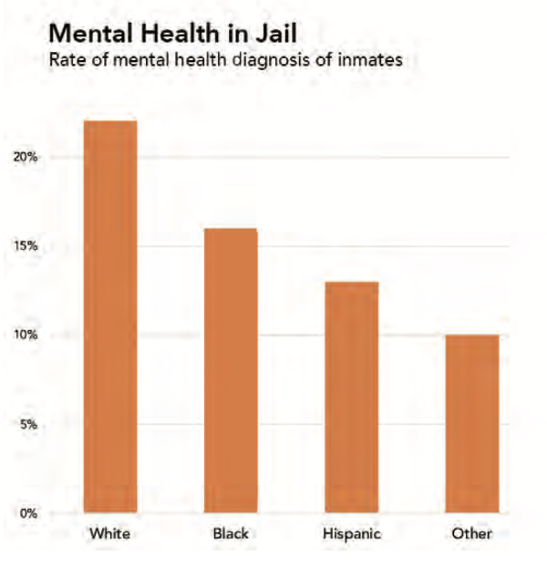
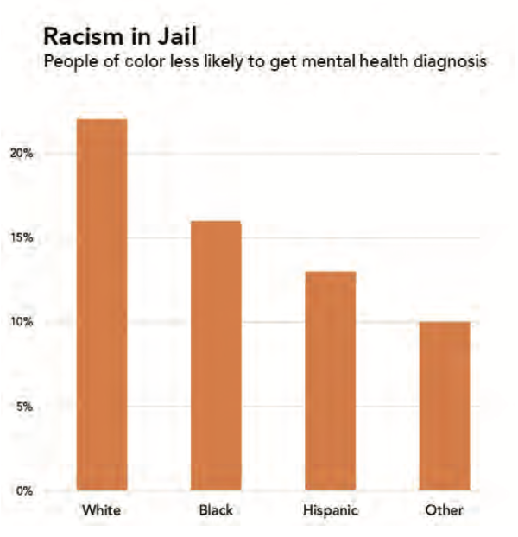
Two portrayals of the same data analysis. The data are from a study of people incarcerated for the first time in NYC jails between 2011 and 2013. Graphics by Catherine D’Ignazio. Data from Fatos Kaba et al., “Disparities in Mental Health Referral and Diagnosis in the New York City Jail Mental Health Service.”
Notes:
Context of first photo

Slide 25
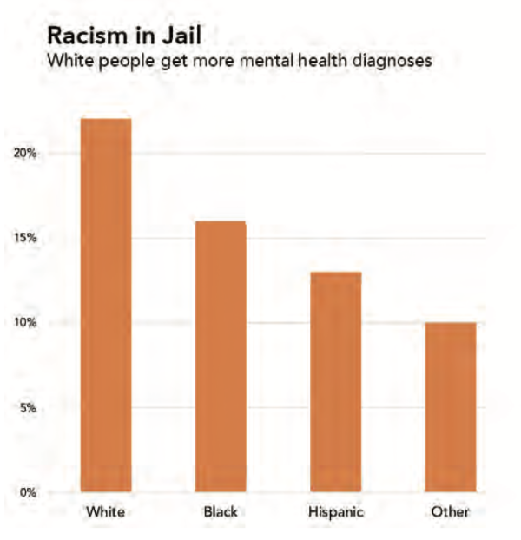
A third portrayal of the same data, with only the framing title and subtitle changed. Source: Data from Kaba et al., “Disparities in Mental Health Referral and Diagnosis in the New York City Jail Mental Health Service.” Graphic by Catherine D’Ignazio. Data from Fatos Kaba et al., “Disparities in Mental Health.”

Slide 26
Chapter 7: Show your work
(make labor visible)
Notes:
The work of data science, like all work in the world, is the work of many hands. Data feminism makes this labor visible so that it can be recognized and valued.

Slide 27
Make labor visible
The invisible labor of data science
Examining data production
Crediting data work
Crediting emotional labor and care work

Slide 28
Conclusion

Slide 29
Questions for us to consider
Can we do assignments or projects that engage more with the community and/or are more connected to current issues?
What ways can we show data (other types of visualization, visceralization, etc.) that we might not have considered before?

Slide 30
Read the book!
I recommend this book because it will make you think about important perspectives you hadn’t considered, and it’s interesting, actionable, and well-written

